Slide 1
Front End Engineering-I Project : FlavourFi (Recipe Finder)
Team Name : Team 11
Team member : Vaibhav Jain (2410991751)
Vansh Pannu (2410991758)
Vinay (2410991779)
Faculty Coordinator : Dr. Mandeep Singh Devgan
Chitkara University Institute of Engineering and Technology,
Chitkara University, Punjab

Slide 2
Table of Contents
Introduction
Problem Statement
Technical Details
Key Features
Project Highlights
Bonus Feature
Conclusion
References/Links used

Slide 3

Introduction
In this project, we are creating a recipe finder application. We have given the application name “ FlavourFi“. This application allows users to search for a wide range of recipes for different dishes. In this, your go-to destination for discovering delicious, easy-to-make recipes from around the world! Whether you're a seasoned chef or just starting out, our site offers a diverse collection of dishes to suit every taste and occasion. Simply input the ingredients you have on hand, and we’ll find the perfect recipe for you. Explore step-by-step guides, customize meals based on dietary preferences, and enjoy cooking like never before on our site.

Slide 4
Problem Statement
In today’s fast-paced world, many individuals face challenges when it comes to meal planning and cooking. Often, people struggle to decide what to cook based on the ingredients they have available, leading to food waste, unhealthy food choices, or unnecessary grocery trips. Additionally, accommodating dietary preferences, time constraints, and different cooking skill levels adds to the complexity of meal preparation. There is a need for a platform that simplifies the process of finding and preparing meals by recommending recipes based on available ingredients, dietary requirements, and cooking expertise, while offering clear instructions, portion control, and customization options. This platform will help users save time, reduce stress, minimize food waste, and promote healthier eating habits by providing personalized recipe recommendations tailored to individual needs and resources.

Slide 5
Technical Details
Creating a recipe finder website involves several technical components. Here’s a breakdown of key area we will typically focus on:
Frontend Development
We will focus on creating a dynamic, responsive user interface that interacts with an API or a backend to fetch recipe data. Here are the technical details for the frontend development:
1.HTML: For structuring the content and layout of the website.
2.CSS: For styling the website. Use pre-processors like Sass or Less to manage complex styles more efficiently.
3.JavaScript: The core language to make the site interactive and handle API requests.

Slide 6
Key Features
Recipe Search Bar - A prominent search function where users can type ingredients, dish names, or dietary preferences to find relevant recipes.
Step-by-Step Instructions - Clear, step-by-step directions for each recipe, often with accompanying images or videos.
Save Recipes - Options to save favorite recipes in a personal collection.
Calories: Users can see the nutritional info of their recipes
Recipe Customization - Some sites allow users to adjust the recipe to fit specific dietary needs or ingredient availability.
User Profile - A personal account system where users can save recipes, track your favorites.

Slide 7
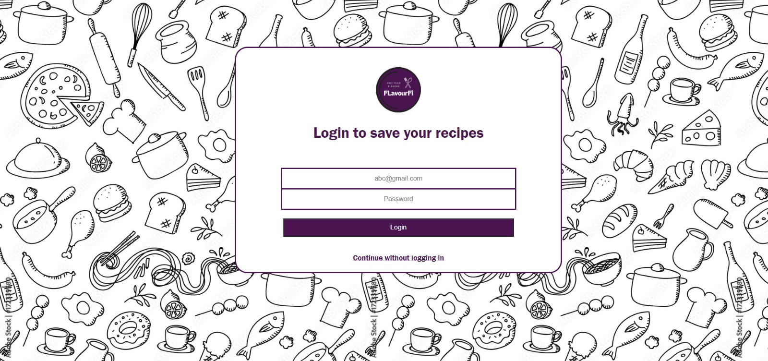
Login Page of site
Project Highlights

Slide 8
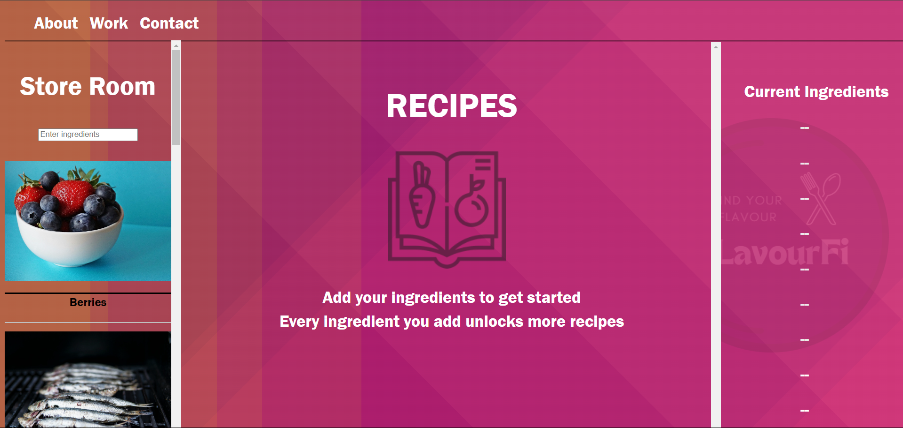
Main Page of site
Project Highlights

Slide 9
Bonus Features
Ingredient-Based Search: Users can input ingredients they have, and the site will suggest recipes that use them.
Personalized Recommendations: The site may offer personalized recipe suggestions based on user preferences, past searches, or ratings.
Step-by-Step Instructions: Detailed cooking instructions, often with accompanying images or videos.
Mobile-Friendly Design: Optimized for mobile browsing, making it easy to search for recipes and follow instructions on smartphones.

Slide 10
Conclusion
Recipe application has a function to find recipes with ingredients that match what is owned by the user . This is a
personalized app which is useful to those who don’t know cooking. Users can find recipes either by selecting
ingredients from the application or by using image processing method to scan the list of available ingredients to get
the recipes accordingly. Based on users health preferences ,the recipes are filtered.

Slide 11
References/Links used
References
https://www.supercook.com/#/desktop
Web Development Resources:
W3school: https://www.w3schools.com/
Bootstrap: https://getbootstrap.com/
Additional Resourses:
Youtube: YouTube
Google: Google Chrome Web Browser
ChatGPT: ChatGPT
Css Gradient Finder: https://www.gradientmagic.com/collection/complexshapes

Slide 12
THANK YOU

